Slide 1
INTRODUCTION
Our team, named “Just Met" is a diverse group of students passionate about mental health and technology. We bring together knowledge in software development, user experience design, psychology, and mental health counseling. With a shared commitment to creating meaningful solutions, we've embarked on the journey of developing the “REVIVE" mental well-being app.​
Our team consists of:​
Khushi Rathi (II Year, B.tech)(Team Leader)​
Paridhi Jain (II Year, B.tech)​
Palak Varshney (II Year, B.tech)

Slide 2
PROBLEM STATEMENT
We aim to develop a one-stop solution for everyone. Mental health is a growing concern worldwide. Our innovative well-being app is designed to revolutionize the way we approach mental health. With cutting-edge features and advanced technology, our app will change the game for mental health care.
Objective: REVIVE aims to provide users with tools and resources to improve their mental well-being through mindfulness, self-care, and positive habit-building.

Slide 3
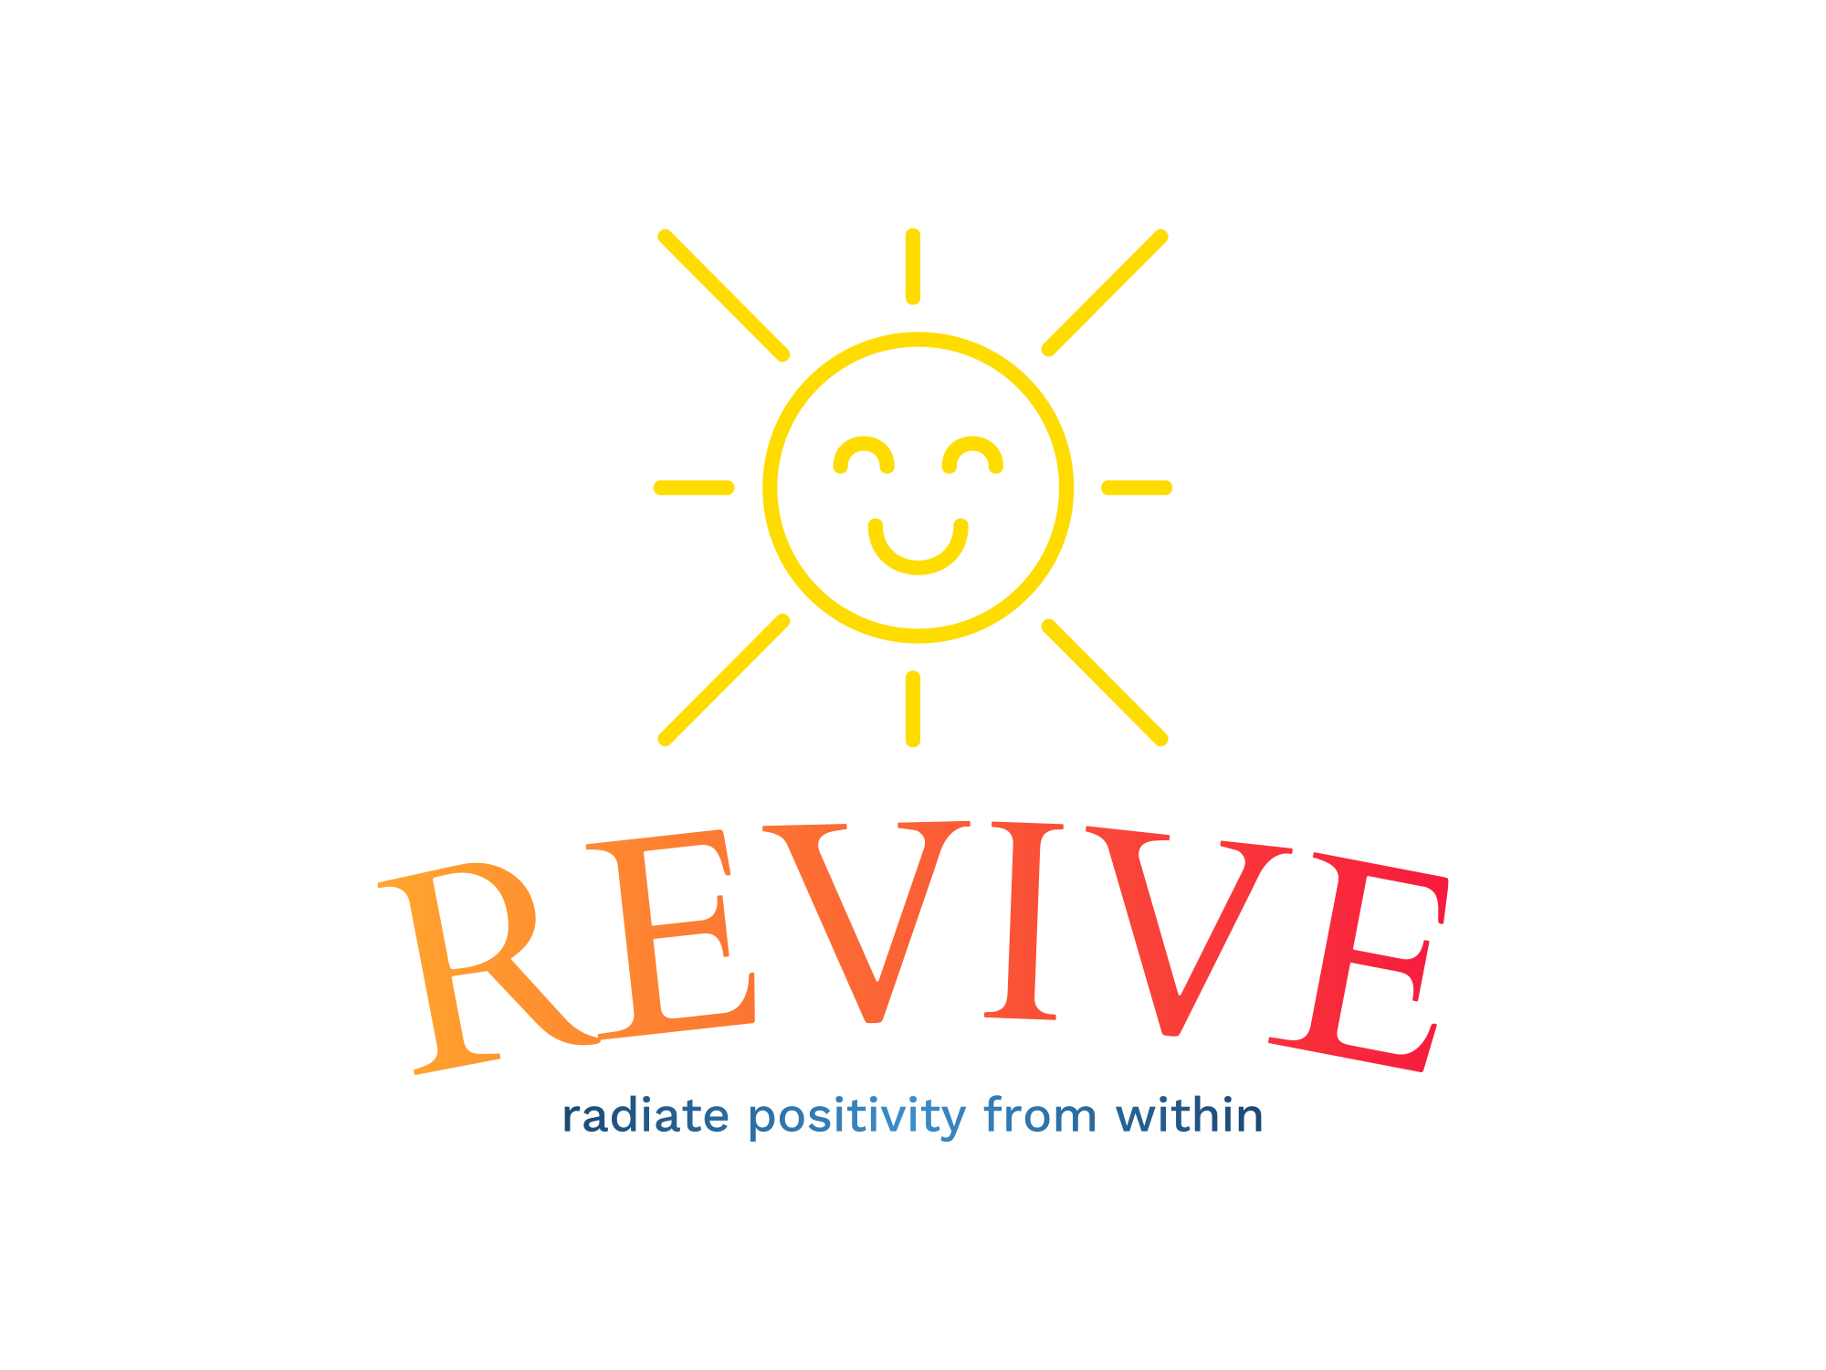

Slide 4

WHAT IS REVIVE?
REVIVE isn’t your average mental well being app, it’s a lifeline for students drowning in a sea of stress. Our cutting- edge solution is tailor –made for studious minds, offering unprecedented support in achieving emotional, mental, and academic success.
Say goodbye to panic attacks, burnout, and procrastination. REVIVE’s innovative approach integrates proven mindfulness techniques, study tips, and personalized pep talks to help students stay calm, confident and focused.

Slide 5
WHAT MAKES REVIVE DIFFERENT?
HOLISITC WELL-BEING APP
COMMUNITY
SUPPORT
EMPHASIS ON HABIT FORMATION
INTEGRATION OF POSITIVE PSYCHOLOGY
EMERGENCY RESOURCES AND CRISIS SUPPORT
USER CENTRIC DESIGN

Slide 6
The REVIVE app encompasses a range of features, from mood tracking to mindfulness meditation and community engagement. Integrating personalized content and emergency support while maintaining a seamless user experience adds a layer of complexity to the development process.
The feasibility of the REVIVE app is bolstered by the current state of mobile app development, coupled with the utilization of existing APIs for mood tracking and the integration of established mindfulness practices.
The app's practicability is evident in its ability to cater to users' diverse needs. Incorporating features like mood tracking, gratitude journaling, and goal setting aligns with users' desire for self-improvement and well-being.
COMPLEXITY
FEASIBILITY
PRACTIBALITY

Slide 7
SCOPE FOR FUTURE ADDITIONS
CONTENT EXPANSION
RESEARCH AND INSIGHTS
GLOBAL OUTREACH
VIRTUAL REALITY INTEGRATION
ADVANCED AI
AND PERSONALISATION
SCHOOLS
AND ORGANISATIONS

Slide 8
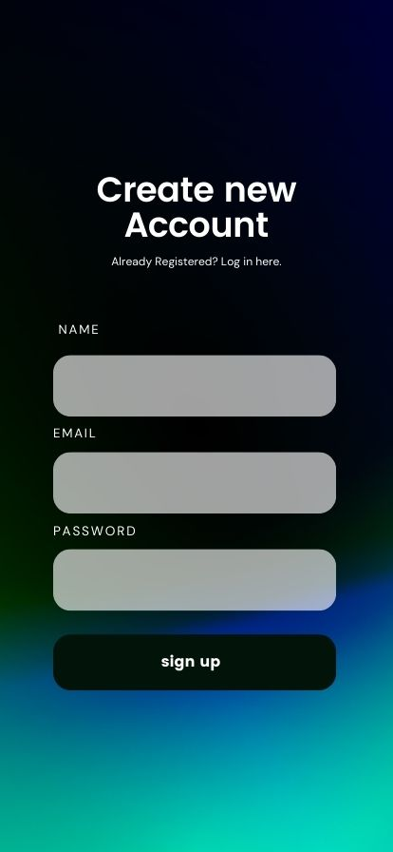







APPENDIX
How do you feel at the moment ?
Chat with friendly AI
LOGIN AND SIGN IN PAGE
MOOD TRACKER
CHAT BOT
REVIVE YOUR MIND
CONSULTANCY PAGE
DIGITAL JOURNAL
GET REGULAR FEEDBACK
Hi! Welcome to REVIVE! How can we help you?
Moderate
Good
I am doing okay, I guess…
Do you want to talk about it?
Very Good
Bad
Very Bad

Slide 9

For Queries:
letsreviveourself@gmail.com

